Slide 1
SDN Control Plane & SDN Application Plane
Bansari Patel
CS374 –MODERN NETWORKS
DECEMBER 2021– JULY 2022
Teaching cum. Research Assistant
Computer Science and Engineering
18-01-2022

Slide 2
Chapter Objectives
SDN architecture
SDN control Plane architecture
SDN controller implementation
Southbound interfaces
Northbound interfaces
OpenDaylight
REST
Cooperation and coordination among controllers

Slide 3
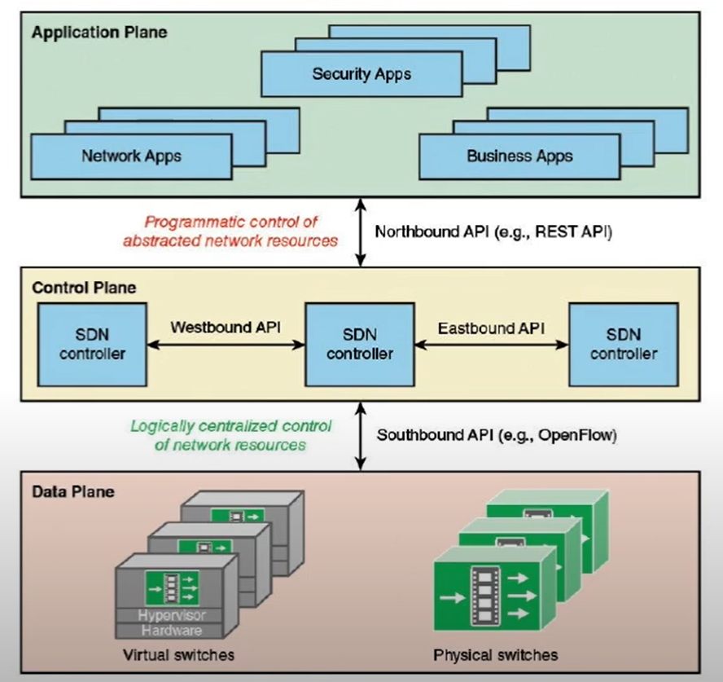
SDN architecture

Slide 4
SDN control Plane architecture
Maps application layer service requests into specific commands and directives to data plane switches.
Supplies applications with information about data plane topology and activity.
The control layer is implemented as a server or cooperating set of servers known as SDN controllers.

Slide 5
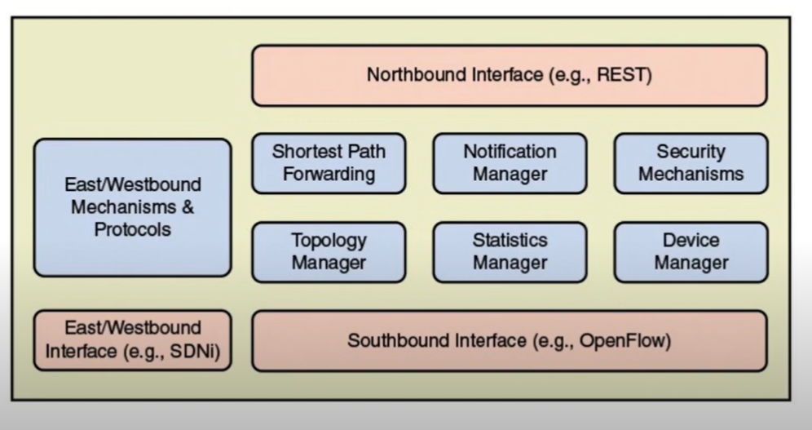
SDN control Plane architecture – Control plane functions

Slide 6
SDN controller implementation
A number of different initiatives have resulted in SDN controller implementations
OpenDaylight
Open Network Operating System (ONOS)
POX
Beacon
Floodlight
Ryu
Onix

Slide 7
Southbound interfaces
A provides the logical connection between the SDN controller and the data plane switches.
Some support only a single southbound protocol.
More flexible approach support multiple southbound APIs.

Slide 8
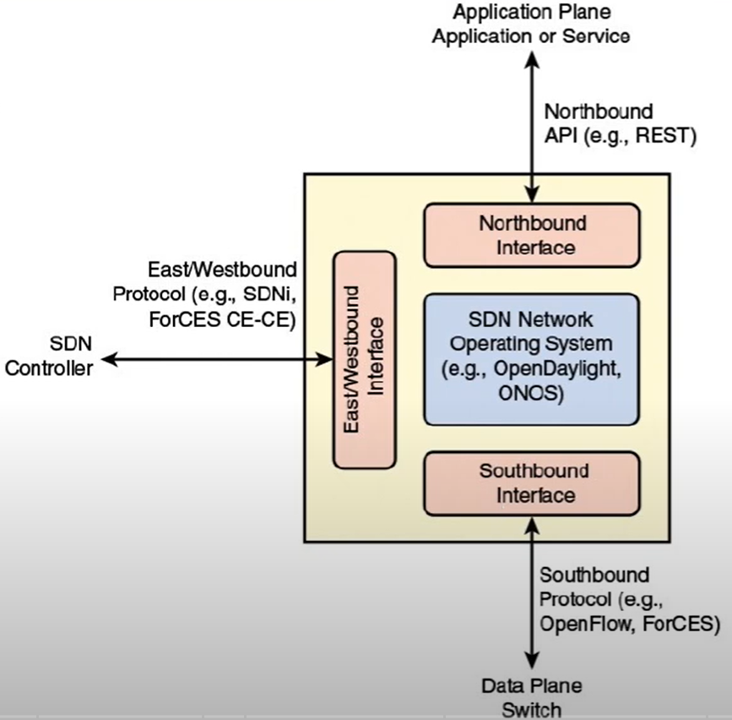
Southbound interfaces
OpenFlow
Open vSwitch Database Management Protocol (OVSDB)
Forwarding and Control Element Separation (ForCES)
Protocol Oblivious Forwarding (POF)

Slide 9
Northbound interfaces
Enables applications to access control plane functions and services.
No need to know the details of the underlying network switches.
No widely accepted standard for the northbound interface.
A number of unique APIs have been developed.

Slide 10
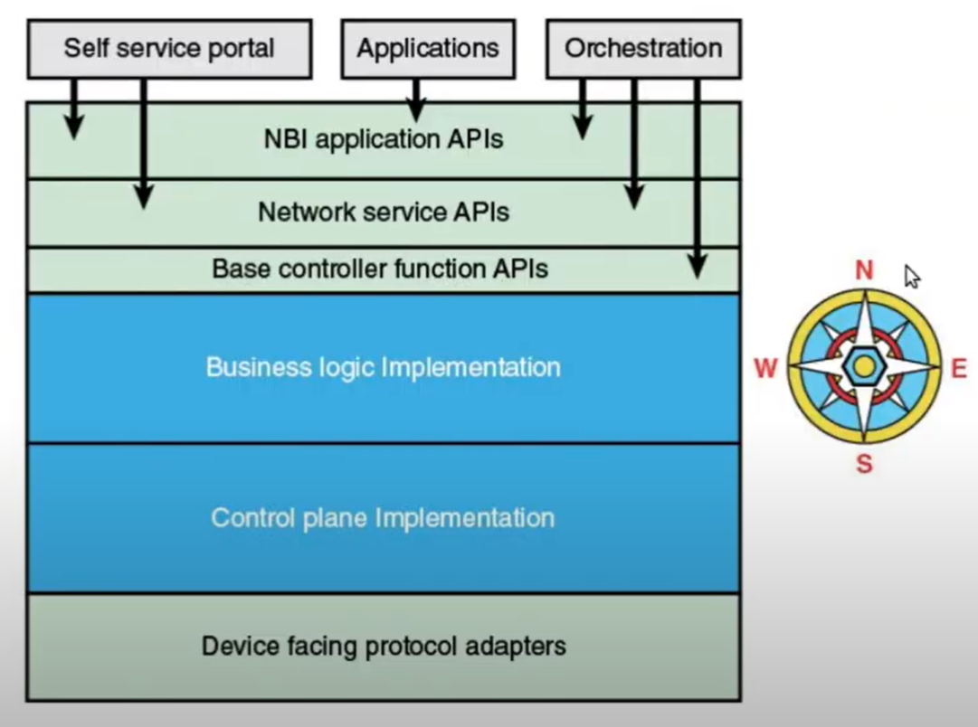
Northbound interfaces

Slide 11
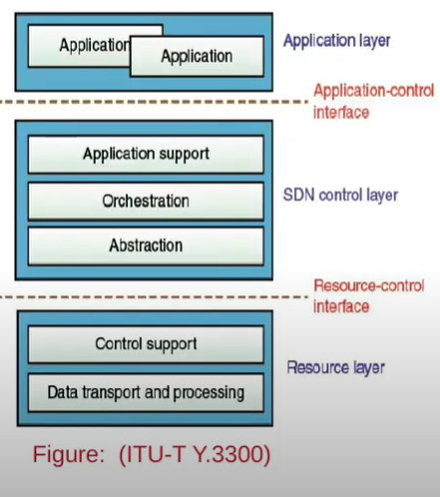
ITU-T Model
High-level architecture defined in ITU-T Y.3300.
Consists of three layers.
Application Layer
Application/Services
Control Layer
Application Support
Orchestration
Abstraction
Resource Layer
Control Support
Data transport and processing

Slide 12
OpenDaylight
Open source project.
Hosted by the Linux Foundation.
Every major networking organization is a part.
Aims to produce an extensible, open source, virtual networking platform.

Slide 13
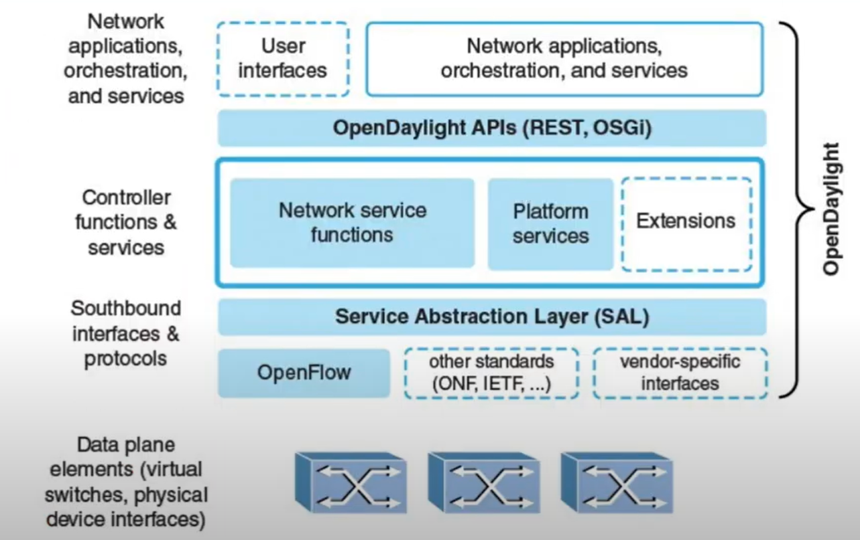
OpenDaylight Architecture

Slide 14
Representational State Transfer (REST)
An architectural style used to define APIs.
Standard way of constructing northbound APIs.
Six constraints that an API must follow to be RESTful.
Client-Server
Stateless
Cache
Uniform interface
Layered system
Code on Demand

Slide 15
Cooperation and coordination among controllers
A key architectural design issue is to decide:
Whether a single centralized controller or a distributed set of controllers will be used.
A centralized controller is a single server that manages all the data plane switches.
Large enterprise divides the whole network into a number of nonoverlapping SDN domains, managed by distributed controllers.

Slide 16
SDN Application Plane
SDN application plane architecture
Network services abstraction layer
Traffic engineering
Security
Data center networking
Information centric networking

Slide 17
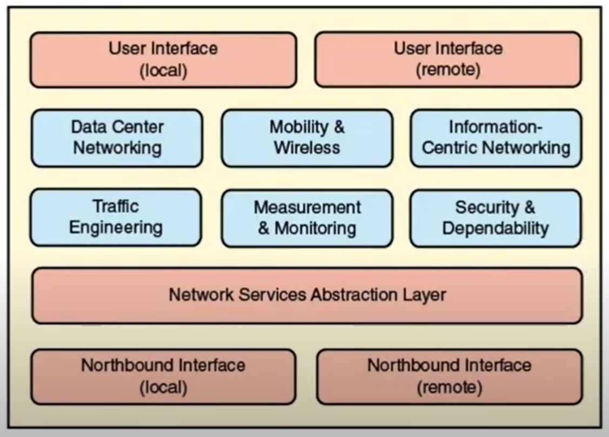
SDN application plane architecture

Slide 18
Network services abstraction layer
Abstraction
The amount detail about lower levels of the model that is visible to higher levels.
More abstraction means less detail.
Less abstraction means more detail.
Abstraction Layer
A mechanism that translates a high-level request into the low-level commands required to perform the request.
An API is one such mechanism

Slide 19
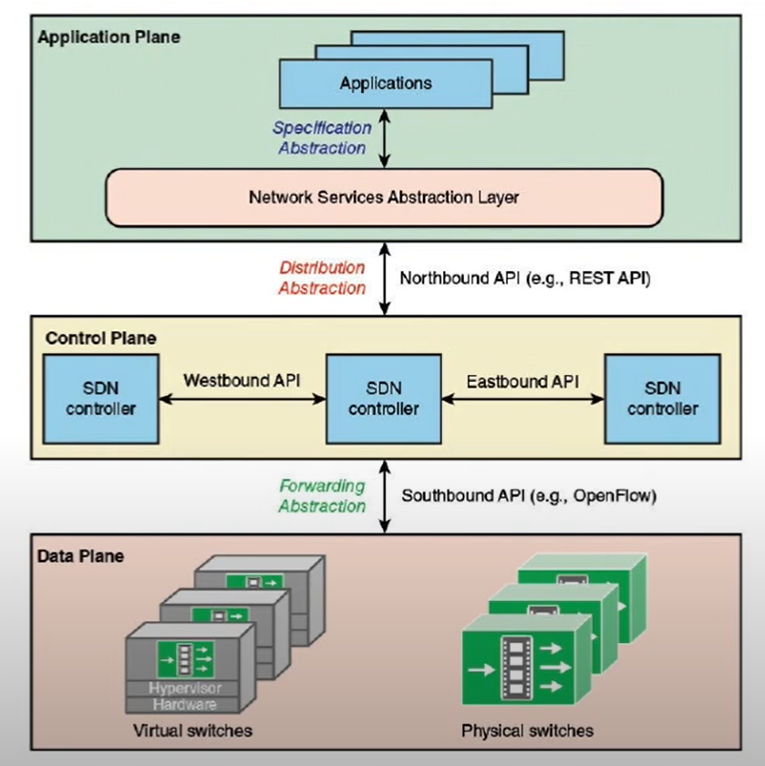
Network services abstraction layer – Abstraction in SDN

Slide 20
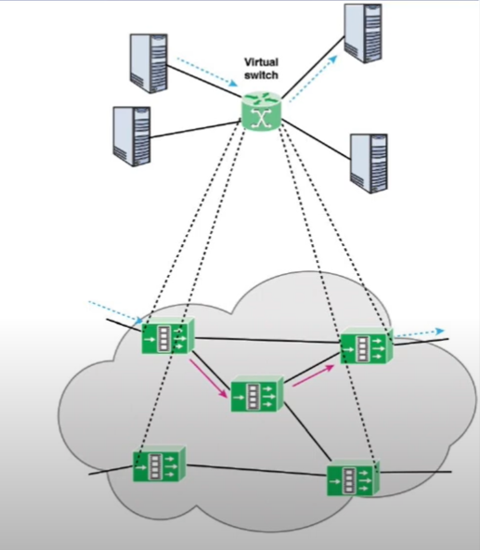
Network services abstraction layer – Abstraction in SDN
Forwarding Abstraction
Distribution Abstraction
Specification Abstraction

Slide 21
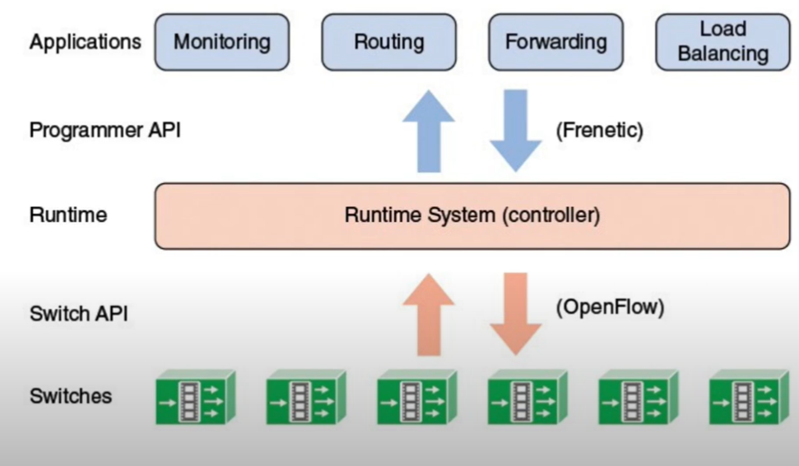
Network services abstraction layer – An example: Frenetic Architecture

Slide 22
Traffic Engineering
Method for dynamically analyzing, regulating and predicting the behavior of data flowing in networks with the aim of performance optimization to meet SLAs.
Load Balancing
Energy-aware routing
Scheduling/optimization
Traffic engineering with minimal overhead
Fast recovery
QoS enforcement
Divide and spread forwarding tables

Slide 23
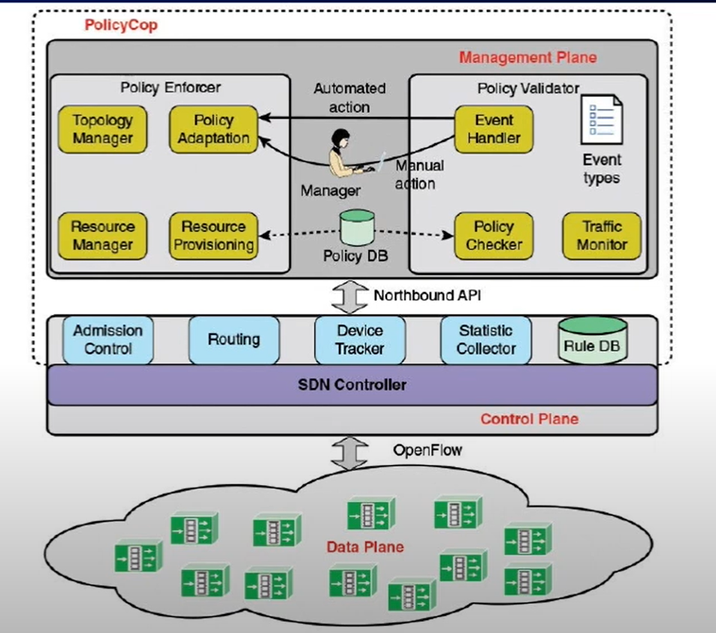
Traffic Engineering - PolicyCop

Slide 24
Security
Applications in this area have one of the two goals
Address security concerns related to the user of SDN
Use the functionality of SDN to improve network security

Slide 25
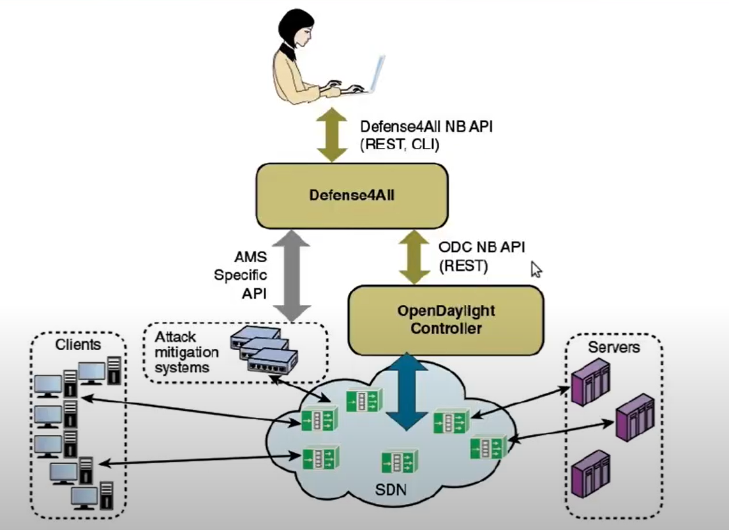
Security – OpenDaylight DDoS Application

Slide 26
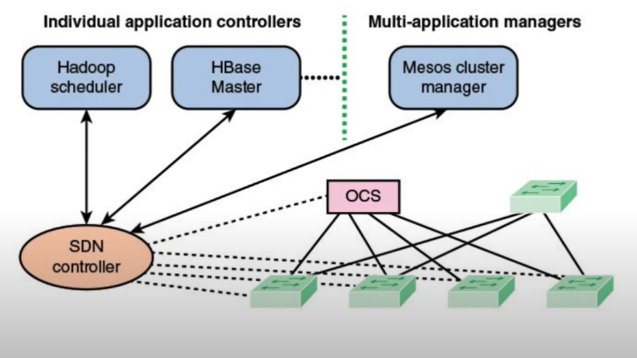
Big Data over SDN

Slide 27
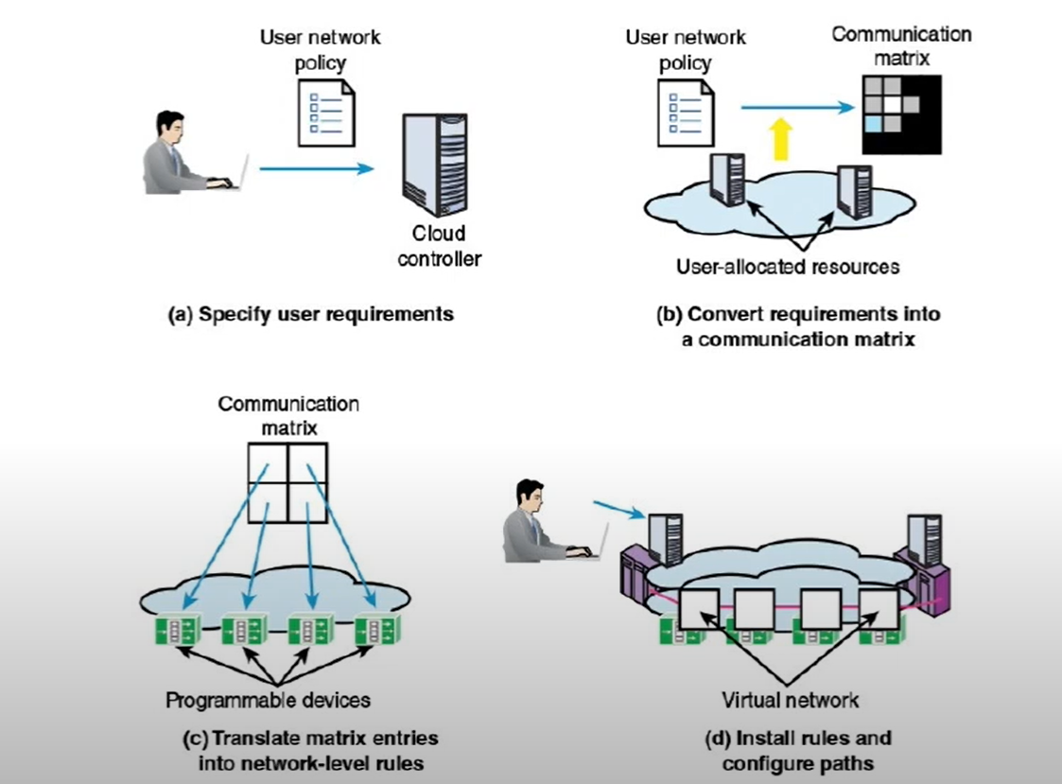
Cloud Networking over SDN

Slide 28
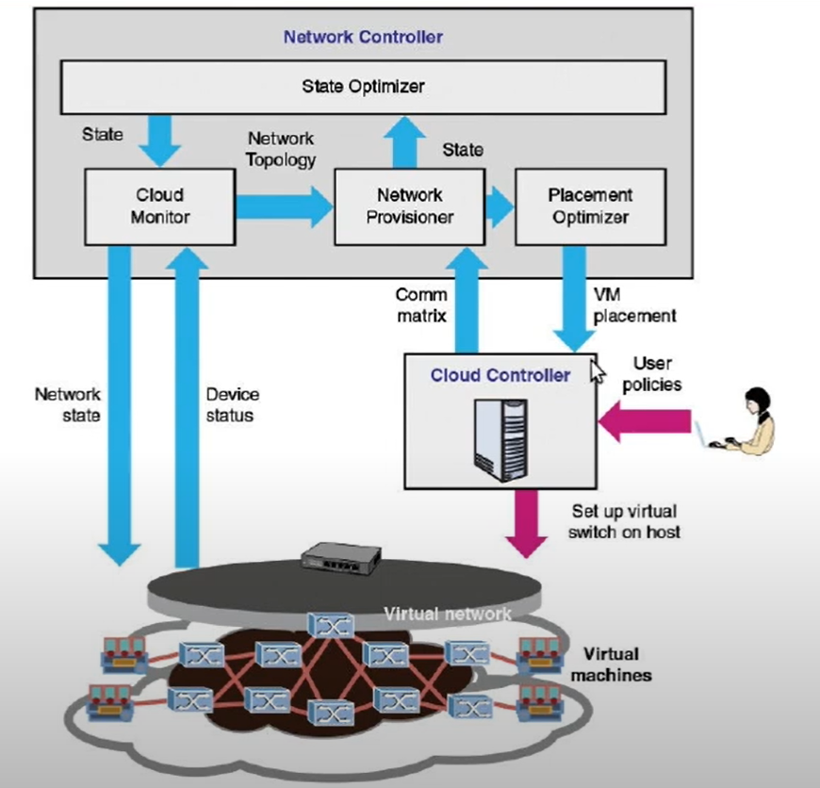
Cloud Networking over SDN

Slide 29
Information Centric Networking
Also known as Content Centric Networking (CCN)
Host Centric Networking
In traditional host centric networking paradigm the information is obtained by contacting specified named hosts
Information Centric Networking
The ICN aimed at providing native network primitives for efficient information retrieval by directly naming and operating on information objects.

Slide 30
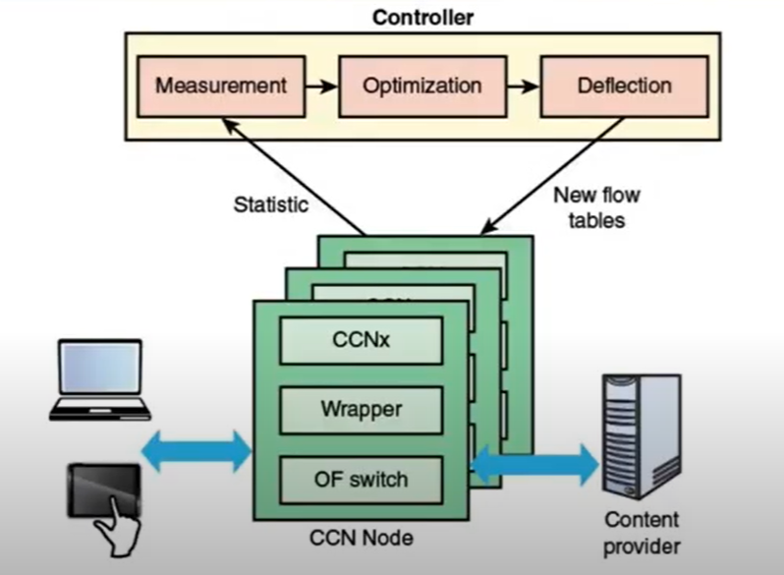
Information Centric Networking - CCNx

Slide 31
Assignment Questions
What is Network Controller in SDN?
What are the central tasks of the Control Plane with its Network Controller?
What is the advantage of central intelligence over distributed intelligence in SDN?
How does control plane and data place communicate in SDN?
Explain Traffic Engineering with example.
How SDN works with Big Data and Cloud computing ?
What is the work of Network services abstraction layer ?

Slide 32
Thankyou

